Slide 1







SmartCart: Revolutionizing E-Commerce in India with AI-Powered Personalized Product Recommendations

Slide 2
Presentation By :
MANOHAR S (1CD21EC072)
VEENA R (1CD21EC171)
VINEET DHARWADKAR (1CD21EC176)

Slide 3

Table of contents
Introduction
Proposed Plan
01
02
A brief on Presentation
Information about our Plans and Procedures
Conclusion
Project Demonstration Strategy
03
04
The brief of strategies used in the project to get expected outcomes
The overall view of the presentation in few words

Slide 4

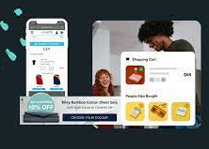
Introduction
01
Exploring the Rise of Online Shopping: Navigating Competitive Global Marketplaces via Google and Beyond which emphasizes the emerging trend of online shopping and the competitive landscape: "Unveiling the Dynamics of Online Shopping” Resulting in Adverse Effects on Small Businesses, Particularly MSME Sectors.

Slide 5

Background Information
Domain Information
Problem Description
In today's Indian urban setting, as well as in rural areas, development across all sectors is rapidly expanding thanks to online services, doorstep solutions, and other transformative initiatives. With urbanization on the rise and technology shaping increasingly complex lifestyles, simplifying shopping experiences has become crucial.
Existing online shopping platforms encounter numerous issues, including the influence of sponsored products, a lack of serendipity, limited context, bias and manipulation. These challenges predominantly impact on online shopping.
Receiving incorrect or misplaced orders can be frustrating for customers and can cause delays in obtaining the correct items, adding to their dissatisfaction with the online shopping experience.

Slide 6
Possible Applications
Development of Enhanced E-Commerce Platforms
Integration of Smart Recommendation Systems
Trust-building Initiatives
Partnerships with Local Businesses
Educational Campaigns

Slide 7
Motivation for selection Of The Project
In recognizing the challenges faced by both consumers and local businesses in the online shopping landscape, I am motivated to embark on this project with a determination to foster positive change.
By addressing issues such as biased product recommendations, lack of transparency, and trust deficits, I aim to contribute towards creating a more equitable and fulfilling online shopping experience for all stakeholders. Through innovative solutions and collaborative efforts, I aspire to empower local businesses, enhance customer satisfaction, and ultimately, shape a more resilient and inclusive e-commerce ecosystem.

Slide 8
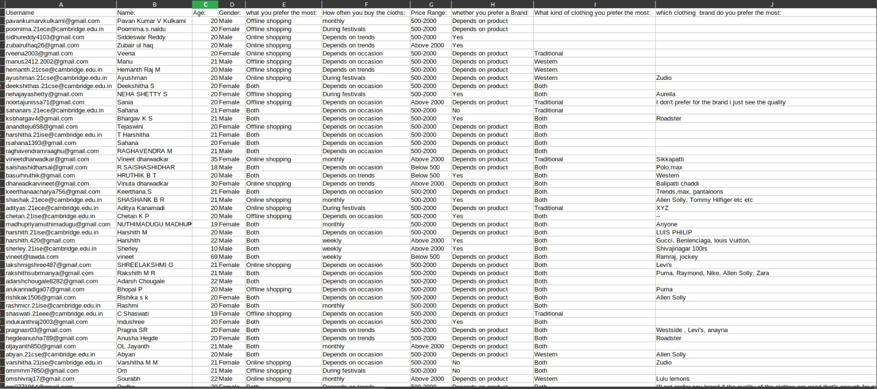
The Dataset we collected

Slide 9
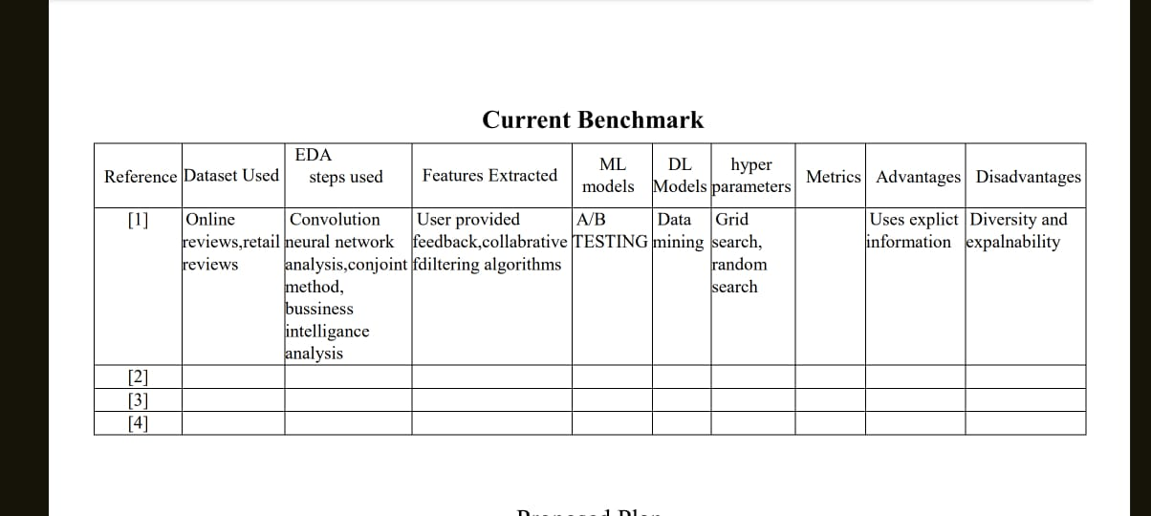
Literature Review Table:

Slide 10
Proposed Plan
Approaches
METHODOLOGY
Stages with Defined Deliverables
Phases and approaches towards the Project plan
Packages and Tools
Algorithms
Metrics
Deployment Plan
Stages following the desired deliverables

Slide 11
Approaches
Research Phase
Identification of Issues in Online Shopping
Understanding the Needs of Local Businesses
Proposing Solutions to Support Local Businesses
Enhancing Customer Experience
Building Trust and Confidence
Collaboration and Partnerships
Monitoring and Evaluation

Slide 12
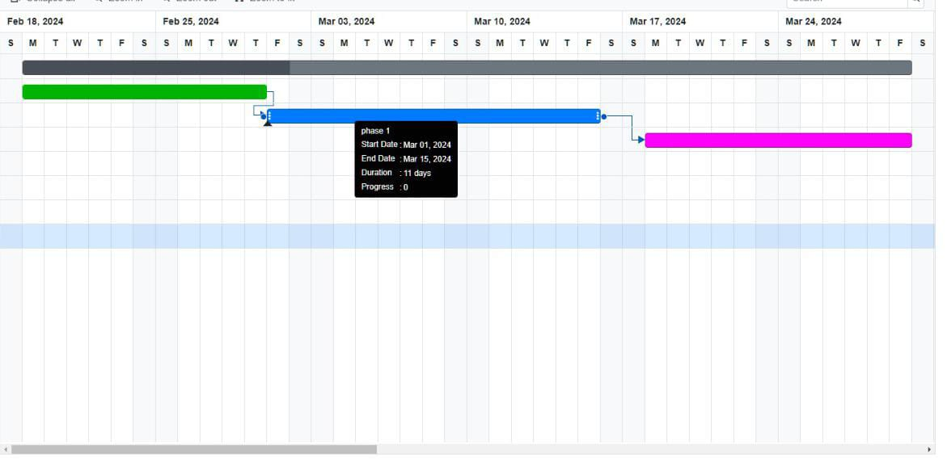
Gant Chart

Slide 13
Stages with Defined Deliverables
Project goals
Data collections
Featured Engineering
AI Algorithm Development
Infrastructure setup
Software development
Integration and Testing
Deployment and Hosting
User training and support
Continuous improvement

Slide 14
Methodologies and Tools
01
02
Packages and Tools
Algorithms
Computer vision and image processing
Statistical modelling
Deep Learning Frameworks
Data Analysis and Manipulation
Information statistical graphics
Web development
Database Management
Authentication and Authorization
Collaborative Filtering
Content-Based Filtering
Hybrid Approaches
Deep Learning Models
Clustering Algorithms:K-means Clustering
Classification and Regression Models
Association Rule Mining
Reinforcement Learning

Slide 15
Methodologies and Tools
03
04
Metrics
Deployment Plan
Accuracy Metrics
Ranking Metrics
Diversity Metrics
Serendipity Metrics
User Engagement Metrics
Offline vs. Online Evaluation:
Offline Evaluation
Online Evaluation
Infrastructure Setup
Software Development
Quality Assurance
Data Security and Privacy
Deployment and Rollout
Monitoring and Maintenance
User Training and Support

Slide 16
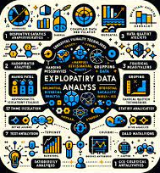
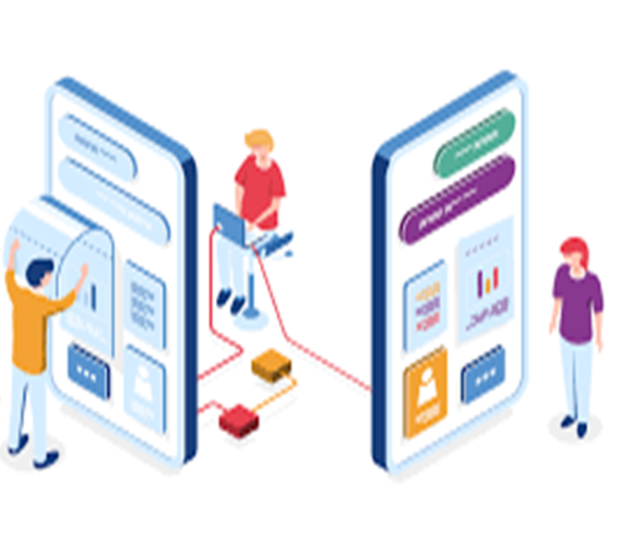
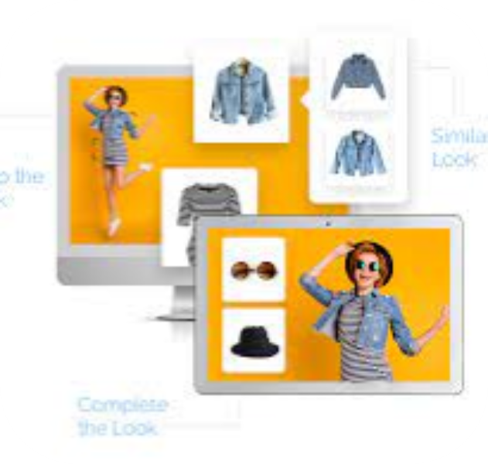
Preliminary Exploratory Data Analysis
Data Overview
Summary Statistics
Univariate Analysis
Bivariate and Multivariate Analysis
Missing Data Analysis
Temporal Analysis
Spatial Analysis
Feature Importance and Selection
Multimodal Data Analysis
Advanced Statistical Analysis
Data Storytelling and Interpretation

Slide 17
EXPECTED OUTCOMES
Input
User Data
Product Data
Contextual Data
External Data
Semantic Data
Collaborative Filtering Data
Graph Data
Temporal Dynamics
Multimodal Data
Output
Recommended Products
Personalization Feature
Real-Time Adaptation
Trending recommendation
Visual Representation

Slide 18
EXPECTED OUTCOMES
Present:
Improved Customer Experience
Support for Local Businesses
Reduction in Return Rates
Increased Trust in Online Shopping
Future:
Sustainable E-commerce Ecosystem
Innovation in Recommendation Systems
Policy Implications
Global Implications

Slide 19
Project Demonstration Strategy
Project Demonstration
Introduction
Model Training and Evaluation
Visual and Interactive Features
Demo Environment Setup
Personalized Recommendations
Performance and Scalability
Data Preparation and Preprocessing
Real-time Adaptation and Feedback Loop
User Feedback and Satisfaction

Slide 20
Conclusion
Our research focuses on utilizing SmartCart's online recommendation system to support and promote small-scale sectors such as MSME. Also aims to contribute to the sustainable development of AI recommendations in SmartCart, reducing return rates and facilitating easy exchanges within one day. Additionally, our project focuses on recommending local shops during online shopping, bridging the gap between online platforms and local availability. This approach allows customers to either visit the local shop or book items online for quick delivery, thereby minimizing return issues.

Slide 21
Thanks!
For your Patience and Kindness

